Slide 1
CS6811-PROJECT WORK
TEAM-46
PROJECT GUIDE : DR. P. Pabitha
Associate professor,
Department of computer technology,
Anna university.
TEAM MEMBERS
Ramya. S (2021503545)
Rupesh.A (2021503549)
Akilan.K (2021503719)

Slide 2
TITLE
AutoML-Driven Predictive Analysis for Insights from Analytic Survey Data
DOMAIN
Artificial Intelligence, Machine Learning, Social Network Analysis.

Slide 3
INTRODUCTION
Machine Learning (ML) helps systems learn and improve from data without manual programming.
Traditional ML is complex and requires manual steps like preprocessing, feature engineering, and tuning.
AutoML simplifies ML by automating the full pipeline, making AI more accessible.
Current AutoML tools have limits with complex data and real-time use, but they’re quickly evolving.

Slide 4
PROBLEM STATEMENT
Manual data loading, cleaning, and EDA processes create bottlenecks in ML development, slowing adoption despite growing industry demand.
Our solution automates these initial steps by supporting common file formats and generating interactive EDA reports with key insights on data quality and patterns.
The system standardizes datasets for downstream use while significantly reducing manual effort and inconsistencies in the early ML workflow.
This semi-automated approach provides a scalable foundation for building complete AutoML pipelines with future model selection and adaptive learning capabilities.

Slide 5
LITERATURE SURVEY
S. NO | PAPER TITLE | JOURNAL / TRANSACTIONS | SYSTEM PROPOSED | LIMITATIONS
1. | Transitioning from MLOps to LLMOps: Navigating the Unique Challenges of Large Language Models S. Pahune, Z. Akhtar | Department of Networks and Computer Security, SUNY Polytechnic Inst., Utica, NY, USA, p.36 ResearchGate (2025) | This paper compares LLMOps(Large Language Model Operations) with MLOps, focusing onthe unique challenges, infrastructure needs,and methodologies for managing LLMlifecycles, such as fine-tuning, deployment and monitoring. | Adaptation to data distribution shifts in dynamic environments.
2. | Meta-Learning in Neural Networks: A Survey T. Hospedales, A. Antoniou, P. Micaelli and A. Storkey | IEEE Transactions on Pattern Analysis and Machine Intelligence, vol. 46, no. 7, pp. 4763-4779, doi:10.1109/TPAMI.2024.3357847(2024) | A comprehensive survey on meta-learning, introducing a new taxonomy to categorize current methods and exploring its applications in few-shot learning and reinforcement learning. | Accurately categorizing diverse meta-learning methods. Struggles with complex multi-modal task distributions.

Slide 6
LITERATURE SURVEY
S. NO | PAPER TITLE | JOURNAL / TRANSACTIONS | SYSTEM PROPOSED | LIMITATIONS
3. | Meta-Learning in Neural Networks: A Survey T. Hospedales, A. Antoniou, P. Micaelli and A. Storkey | IEEE Transactions on Pattern Analysis and Machine Intelligence, vol. 46, no. 7, pp. 4763-4779, doi:10.1109/TPAMI.2024.3357847(2024) | A comprehensive survey on meta-learning, introducing a new taxonomy to categorize current methods and exploring its applications in few-shot learning and reinforcement learning. | Accurately categorizing diverse meta-learning methods. Struggles with complex multi-modal task distributions.
4. | Model Selection for Generic Contextual Bandits A. Ghosh, A. Sankararaman and K. Ramchandran | IEEE Transactions on Information Theory, vol. 70, no. 1, pp. 656-675, Jan.,doi:10.1109/TIT.2023. 3298103(2024) | The Adaptive Contextual Bandit (ACB) algorithm refines model classes in phases, matching the regret rate of algorithms with true model knowledge. It incurs minimal cost in model selection, while a simpler explore-then-commit (ETC) algorithm has higher costs. | Higher model selection cost in ETC compared to ACB.

Slide 7
LITERATURE SURVEY
S. NO | PAPER TITLE | JOURNAL / TRANSACTIONS | SYSTEM PROPOSED | LIMITATIONS
5. | Performance Indicator-Based Adaptive Model Selection for Offline Data-Driven Multiobjective Evolutionary Optimization Z. Liu, H. Wang and Y. Jin | IEEE Transactions on Cybernetics, vol. 53, no. 10, pp. 6263-6276,doi:10.1109/TCYB.203170344(2023) | An adaptive surrogate-assisted evolutionary algorithm is used for switching between Kriging models and RBFNs based on approximation error, to solve the offline data-driven multiobjective optimization problems with up to 10 objectives and 20-30 decision variables. | Depends only on surrogate model quality.
6. | Automatic Title Generation for Text with Pre trained Transformer Language Model P. Mishra, C.Diwan, S.Srinivasa and G.Srinivasaraghavan | IEEE Transactions on Information Theory, vol. 50, no. 1, pp. 656-675, Jan.,doi:10.2109/TIT.2023.3458(2024) | A model that adapts and generalizes using meta-learning for automatic title generation from text. | Handling complex, multi-modal task distributions. Mitigating data distribution shifts.

Slide 8
LITERATURE SURVEY
S. NO | PAPER TITLE | JOURNAL / TRANSACTIONS | SYSTEM PROPOSED | LIMITATIONS
7. | Unsupervised Feature Selection via Controllable Adaptive Graph Learning and Discriminative Feature Learning P. Huang, M. Xie and X. Yang | IEEE Transactions on Neural Networks and Learning Systems, vol. 35, no. 11, pp. 15600-15614(2024) | Unsupervised feature selection faces challenges in preserving intrinsic structure and finding uncorrelated features. CAG-U and CAG-I use adaptive graph learning and discrete projection to overcome inefficiencies in high-dimensional data. | Dependence on prior knowledge of subspace dimension. Inefficiency in handling extremely high-dimensional datasets.
8. | Curiosity-Driven Class-Incremental Learning via Adaptive Sample Selection Q. Hu, Y. Gao and B. Cao | IEEE Transactions on Circuits and Systems for Video Technology, vol. 32, no. 12, pp. 8660-8673(2022) | A curiosity-driven class-incremental learning approach is proposed to reduce catastrophic forgetting by selectively learning informative samples based on uncertainty and novelty, improving model robustness and balance between new and old knowledge. | Dependence on accurate quantification of uncertainty novelty. Potential inefficiency in highly imbalanced datasets.

Slide 9
LITERATURE SURVEY
S. NO | PAPER TITLE | JOURNAL / TRANSACTIONS | SYSTEM PROPOSED | LIMITATIONS
9. | A Self-Adaptive Parameter Selection Trajectory Prediction Approach via Hidden Markov Models S. Qiao, D. Shen, X. Wang, N. Han | IEEE Transactions on Intelligent Transportation Systems, vol. 16, no. 1, pp. 284-2AutoML, meta-learning96(2023) | A hidden Markov model-based trajectory prediction algorithm (HMTP) is proposed to improve accuracy in network-constrained environments. An enhanced version, HMTP*, introduces self-adaptive parameter selection and a density-based partitioning algorithm for better prediction efficiency. | Sensitivity to parameter selection and tuning. Potential inefficiency in highly dynamic environments with abrupt speed variations.
10. | Dynamic Ensemble Selection for Imbalanced Data Streams With Concept Drift B. Jiao, Y. Guo | IEEE Transactions on Neural Networks and Learning Systems, vol. 35, no. 1, pp. 1278-1291(2024) | A dynamic ensemble selection method (DES-ICD) is proposed for handling concept drift and class imbalance in data streams. It employs AnnSMOTE to balance data and selects base classifiers dynamically based on local performance rather than global accuracy. | Increased computational complexity due to local classifier selection.

Slide 10
LITERATURE SURVEY
S. NO | PAPER TITLE | JOURNAL / TRANSACTIONS | SYSTEM PROPOSED | LIMITATIONS
11. | Modyn: DataCentric Machine Learning Pipeline Orchestration M. Bother, T. Robroek, ¨ V. Gsteiger, R. Holzinger, X. Ma, P. Toz¨ un | Proc. Int. Conf. Manage. Data (SIGMOD’25), ACM, New York, NY, USA, pp. 1–30 (2025) | Modyn, a data-centric ML platform, enables continuous model training on growing datasets by applying data selection and triggering policies to optimize retraining costs. | Effectiveness of data selection policies depends heavily on the quality and representativeness of the data.
12. | Advances and Challenges in Meta-Learning: A Technical Review A.Vettoruzzo,M.R. Bouguelia, J. Vanschoren | IEEE Transactions on Pattern Analysis and Machine Intelligence, vol. 46, no. 7, pp. 4763- 4779 (2024) | A meta-learning system to enhance model adaptation and generalization across diverse tasks, particularly in data scarce scenarios. It integrates multi-task learning, transfer learning, and continual learning to improve efficiency and performance. | Adaptation to data distribution shifts in dynamic environments

Slide 11
LITERATURE SURVEY
S. NO | PAPER TITLE | JOURNAL / TRANSACTIONS | SYSTEM PROPOSED | LIMITATIONS
13. | Online AutoML: An Adaptive AutoML Framework for Online Learning B. Celik, P. Singh, J. Vanschoren | Machine Learning, vol. 112, no. 6, pp. 1897–1921, doi: 10.1007/s10994- 022-06262-0 (2023) | An adaptive Online Automated Machine Learning (OAML) system that continuously optimizes learning pipelines in dynamic environments with evolving data distributions. | Inefficiencies in handling highly complex or largescale data streams
14. | Adaptive Model Selection Framework: An Application to Airline Pricing N. Shukla, A. Kolbeinsson, L. Marla, K. Yellepeddi | Journal of Machine Learning Research (JMLR), arXiv:1905.08874v1 [cs.LG], pp. 1-25 (2019) | An adaptive meta-decision framework using Thompson sampling to dynamically route customer requests to different airline pricing models. | Assumes a consistent data stream and prior knowledge.

Slide 12
LITERATURE SURVEY
S. NO | PAPER TITLE | JOURNAL / TRANSACTIONS | SYSTEM PROPOSED | LIMITATIONS
15. | Multitask Learning with Meta-Learning: Optimizing Learning of Multiple Related Tasks A. Ruder, M. E. Peters, M. L. M. Asano | Journal of Machine Learning Research, vol. 20, no. 1, pp. 1897-1921 (2023) | A multitask learning framework optimized through meta learning, enhancing generalization across a wide array of tasks and datasets. | High dependence on prior data quality and representativeness for successful multitask learning.

Slide 13
RESEARCH GAP IDENTIFIED
Existing meta-learning systems struggle to adapt efficiently in highly diverse environments where data distributions change frequently.
Many AutoML models operate as "black boxes," limiting user insight into how models are selected and optimized.
Current meta-learning methods lack precision in handling diverse and complex multi-modal tasks.
Adaptive model selection systems often suffer from high computational costs and inefficiencies due to exhaustive hyperparameter tuning.
Performance inefficiencies due to high complexity.

Slide 14
OBJECTIVES
To automate and streamline ML workflows by optimizing dataset ingestion, preprocessing, and exploratory data analysis, ensuring efficient data handling and preparation.
To improve model selection and hyperparameter tuning by integrating automated techniques like Grid Search and PyCaret’s tuning framework, enhancing predictive accuracy while reducing computational overhead.
To support multi-modal data processing by extending AutoML capabilities to handle structured tabular data and unstructured image-based datasets seamlessly.
To establish a scalable foundation for adaptive learning pipelines, facilitating future automation of model deployment, real-time updates, and advanced analytics.

Slide 15
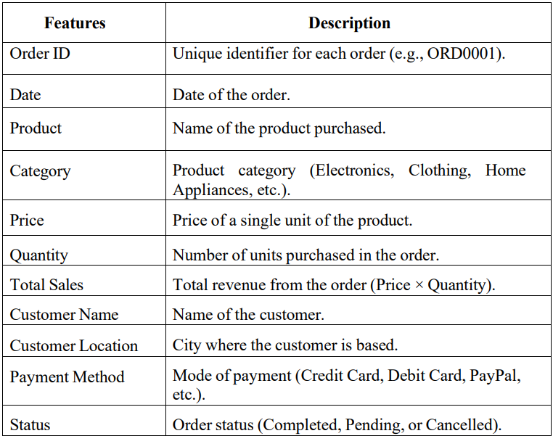
DATASET DESCRIPTION
A. Tabular/Text Dataset
The tabular dataset is obtained from Kaggle and consists of 250 records of Amazon sales transactions(2025), including details about the products sold, customers, payment methods, and order statuses. It includes 11 parameters such as

Slide 16
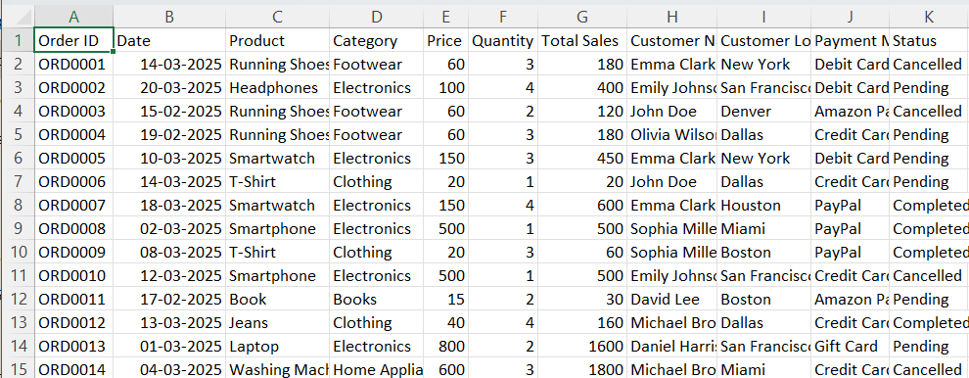
DATASET DESCRIPTION

Slide 17
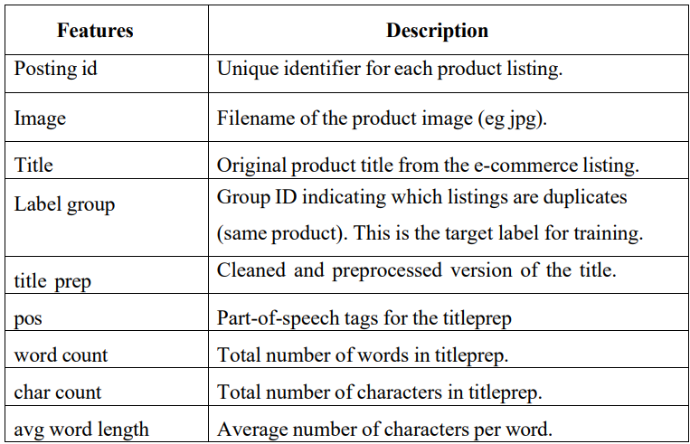
DATASET DESCRIPTION
B. Image Dataset
The image dataset is obtained from Kaggle and consists of 32,412 records of information about product listings from an e-commerce platform(2021). It includes 9 parameters such as

Slide 18
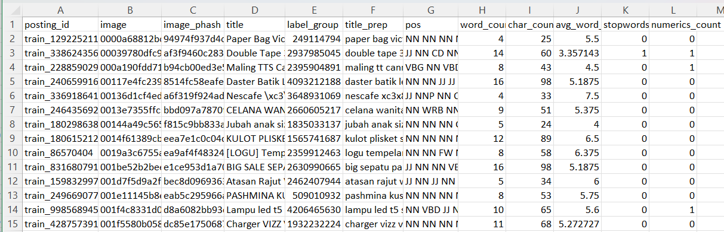
DATASET DESCRIPTION

Slide 19
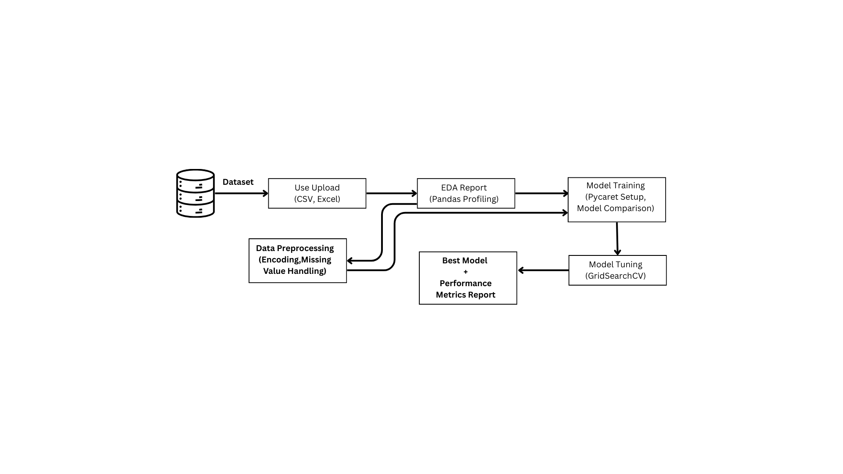
BLOCK DIAGRAM
Block diagram illustrating components of the AutoML-driven predictive analysis framework, showcasing model selection, evaluation, and optimization

Slide 20
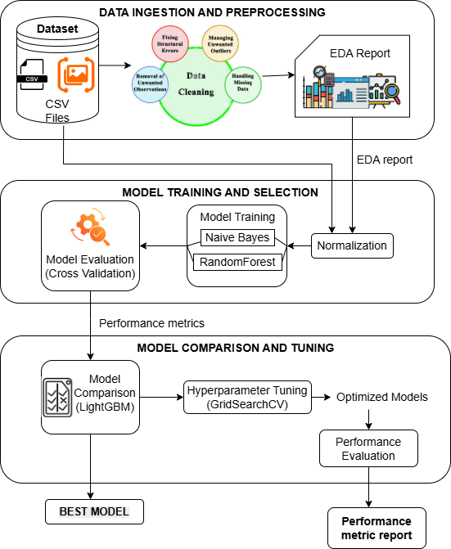
ARCHITECTURE DIAGRAM
Architecture diagram illustrating the structured workflow of the AutoML-driven predictive analysis system.
It outlines the workflow from dataset preprocessing to hyperparameter tuning and model comparison, incorporating LightGBM as a meta-learner.

Slide 21
EXPERIMENTAL SETUP
A. Environment and tools
VS Code, Python 3.9, scikit-learn, XGBoost, LightGBM, CatBoost, NumPy 1.23.5, pandas,
ydata-profiling.
B. Model
Logistic Regression
K-Nearest Neighbors (KNN)
ClassifierNaive Bayes (GaussianNB)
Decision Tree Classifier
Random Forest

Slide 22
EXPERIMENTAL SETUP
Linear Regression
Lasso Regression
Ridge Regression
Least Angle Regression (LARS)
Orthogonal Matching Pursuit (OMP)
Bayesian RidgeHuber
RegressorPassive
Aggressive Regressor

Slide 23

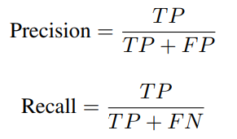

EXPERIMENTAL SETUP
C. EVALUATION METRICS
Accuracy: Accuracy measures the proportion of correctly classified samples over the total number of samples. It is computed as:
Precision, Recall, and F1-Score: These metrics provide detailed insight into model performance, especially for imbalanced data.

Slide 24


EXPERIMENTAL SETUP
Matthews Correlation Coefficient (MCC): MCC is a robust metric that considers all values from the confusion matrix and is particularly useful for imbalanced classes.
Training Time (TT): The time (in seconds or minutes) required to train the model. It is used to compare computational efficiency among models.
Confusion Matrix: The confusion matrix summarizes prediction results by comparing predicted and actual labels. It includes true positives (TP), false positives (FP), true negatives (TN), and false negatives (FN).
Kappa : Kappa measures the agreement between predicted and actual classifications while adjusting for chance. It is useful in imbalanced datasets, where higher values indicate stronger model reliability.

Slide 25
PROJECT MODULES AND DESCRIPTION
A. Data ingestion and preprocessing
Input: User-uploaded dataset file (.csv or .xlsx) via Streamlit File Uploader.
Processing:
Validates the uploaded file type and reads it into a Pandas DataFrame.
Saves the validated DataFrame as source data.csv for later access.
Standardizes column names and fills missing values in categorical columns with default placeholders.
Generates an interactive EDA report using the cleaned dataset.
Outcome: Cleaned and saved dataset (source data.csv) and automatically generated EDA Report.

Slide 26
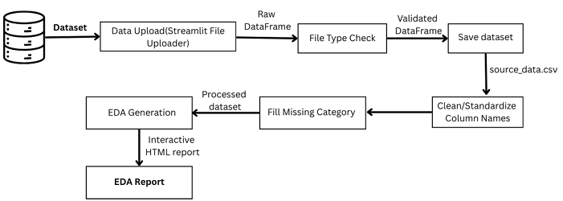
PROJECT MODULES AND DESCRIPTION
Workflow of Data ingestion and Data preprocessing Module

Slide 27
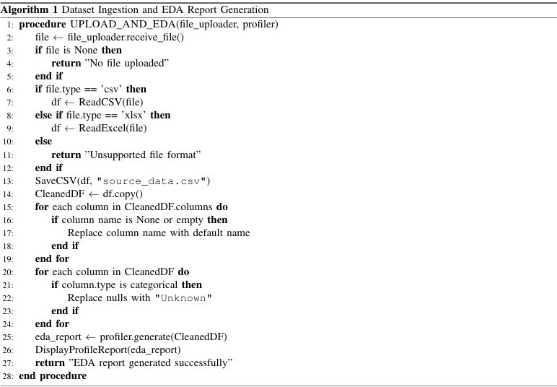
WORKING PSEUDOCODE

Slide 28
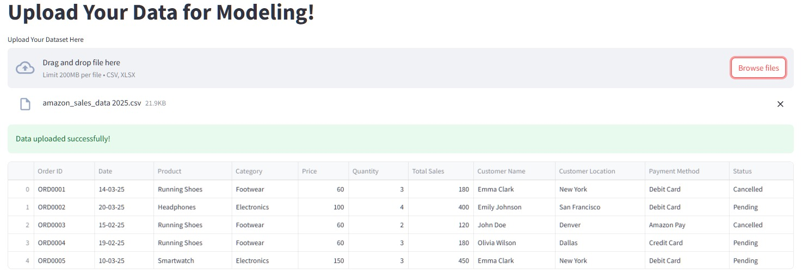
IMPLEMENTATIONS AND OUTPUTS
A data upload interface from the AutoML-driven predictive analysis system, showcasing an uploaded dataset preview with structured columns for preprocessing.

Slide 29
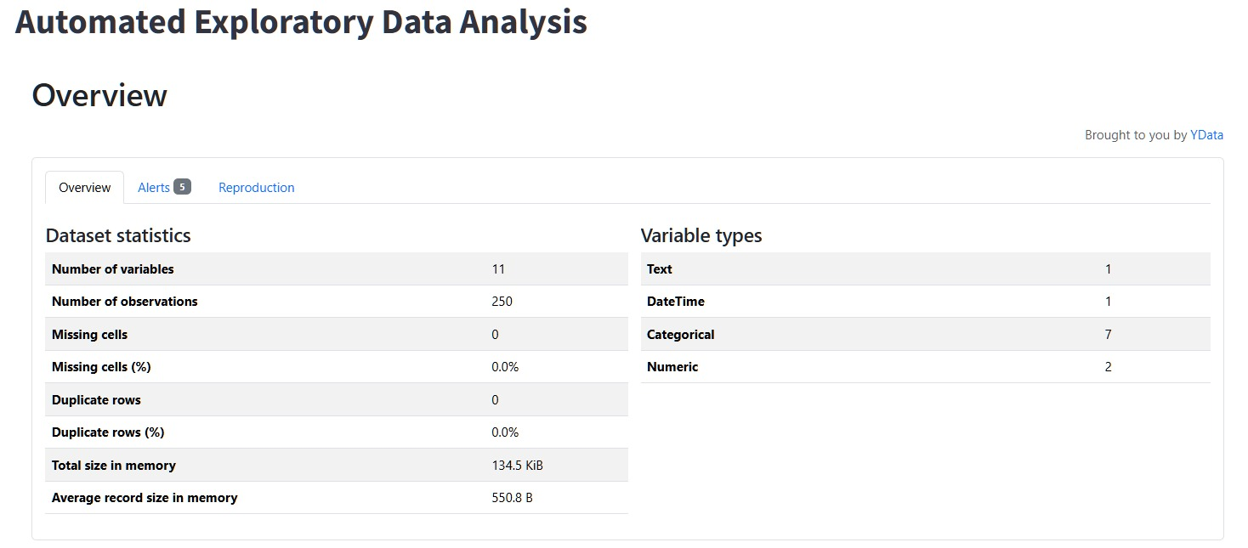
IMPLEMENTATIONS AND OUTPUTS
An automated exploratory data analysis (EDA) report, summarizing dataset statistics, variable types, memory usage, and missing values.

Slide 30
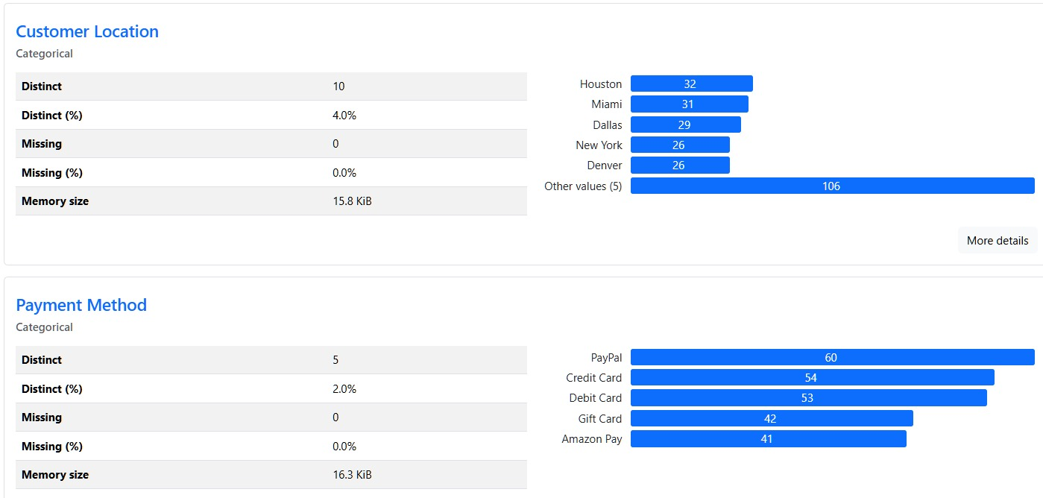
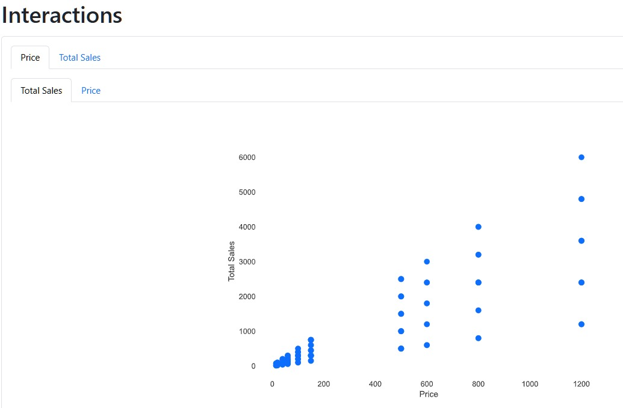
IMPLEMENTATIONS AND OUTPUTS
Report generated by the Exploratory Data Analysis for the upload dataset

Slide 31
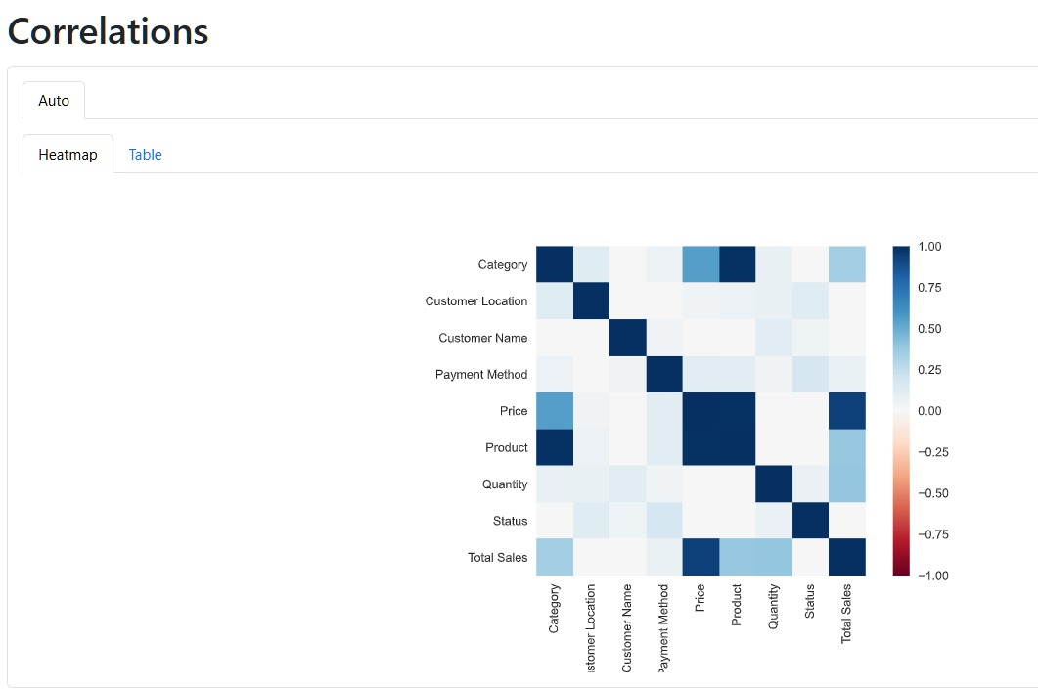
IMPLEMENTATIONS AND OUTPUTS
A correlation heatmap visualizing relationships between key variables such as category, price, quantity, payment method, and total sales, highlighting the strength and direction of dependencies.

Slide 32
PROJECT MODULES AND DESCRIPTION
B. Model Training and Selection
Input: Processed dataset from EDA stage (numeric, labeled data) and user-selected target variable.
Processing:
Label encoding is applied to categorical columns to convert them into numeric format.
Mode imputation is used to handle missing values in scalar fields.
PyCaret setup is initialized and Models (e.g., RandomForest, LightGBM) are trained, and the best-performing one is selected based on evaluation metrics.
Optimize models with GridSearchCV for hyperparameter tuning.

Slide 33
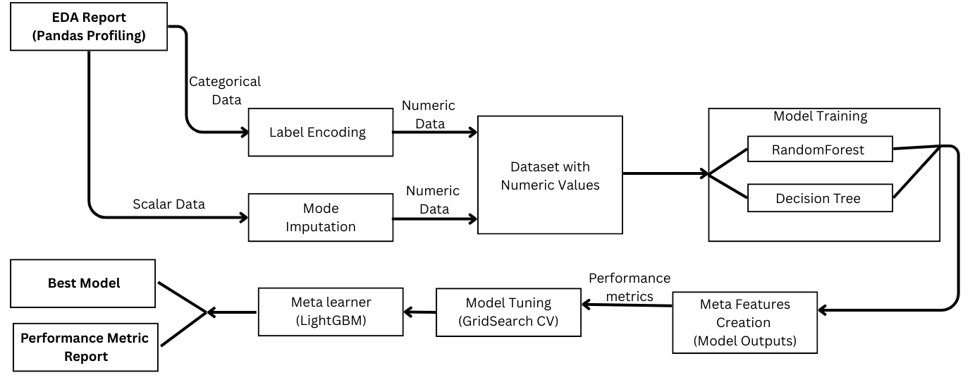
PROJECT MODULES AND DESCRIPTION
Outcome: Trained best models and performance metric report summarizing model evaluation results (Accuracy, AUC, F1-score, etc.).

Slide 34
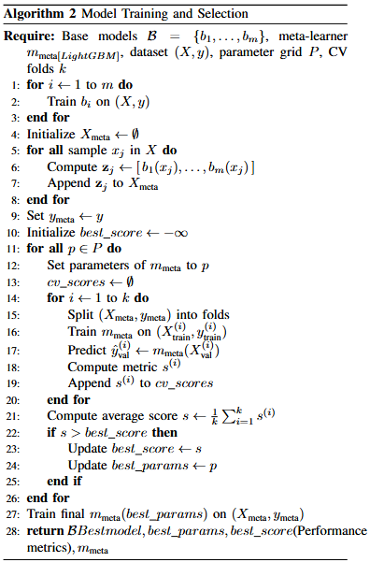
WORKING PSEUDOCODE

Slide 35
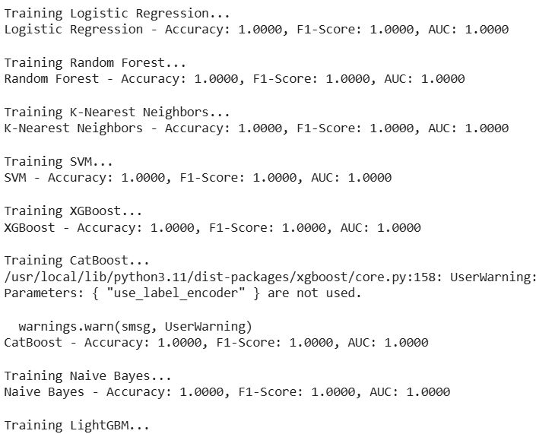
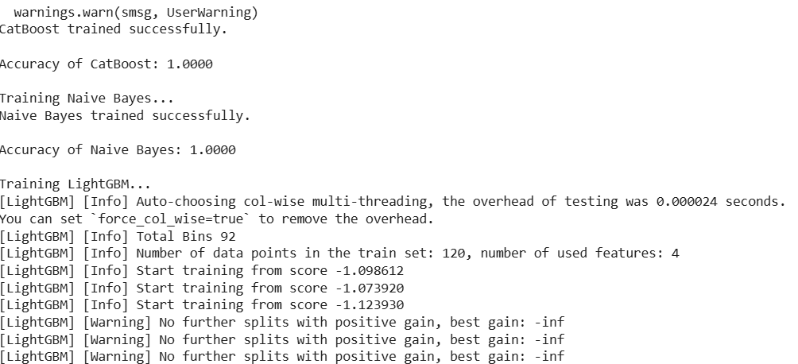
IMPLEMENTATIONS AND OUTPUTS
Training results of multiple machine learning models, including Logistic Regression, Random Forest, K-Nearest Neighbors, SVM, XGBoost, CatBoost, and Naive Bayes, all achieving perfect accuracy, F1-Score, and AUC.

Slide 36
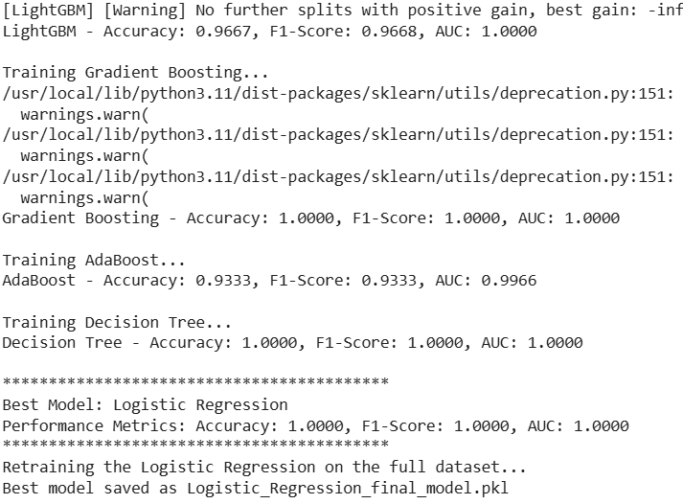
IMPLEMENTATIONS AND OUTPUTS
Performance evaluation of various machine learning models, showcasing accuracy, F1-score, and AUC values, with Logistic Regression emerging as the best model.

Slide 37
PROJECT MODULES AND DESCRIPTION
C. Model comparison and Tuning
Input: Trained best model and metrics report.
Processing:
Train multiple models and evaluate their performance using cross-validation and predefined metrics.
Apply GridSearchCV to fine-tune hyperparameters for better efficiency.
Rank models using LightGBM as a meta-learner, comparing them based on validation accuracy and overall scores.
Select the best model, retrain it on the full dataset with optimized hyperparameters, and prepare it for deployment.
Output: Best Model Selection based on comparative evaluation and Performance Metric Report detailing accuracy, precision, recall, and other validation metrics.

Slide 38
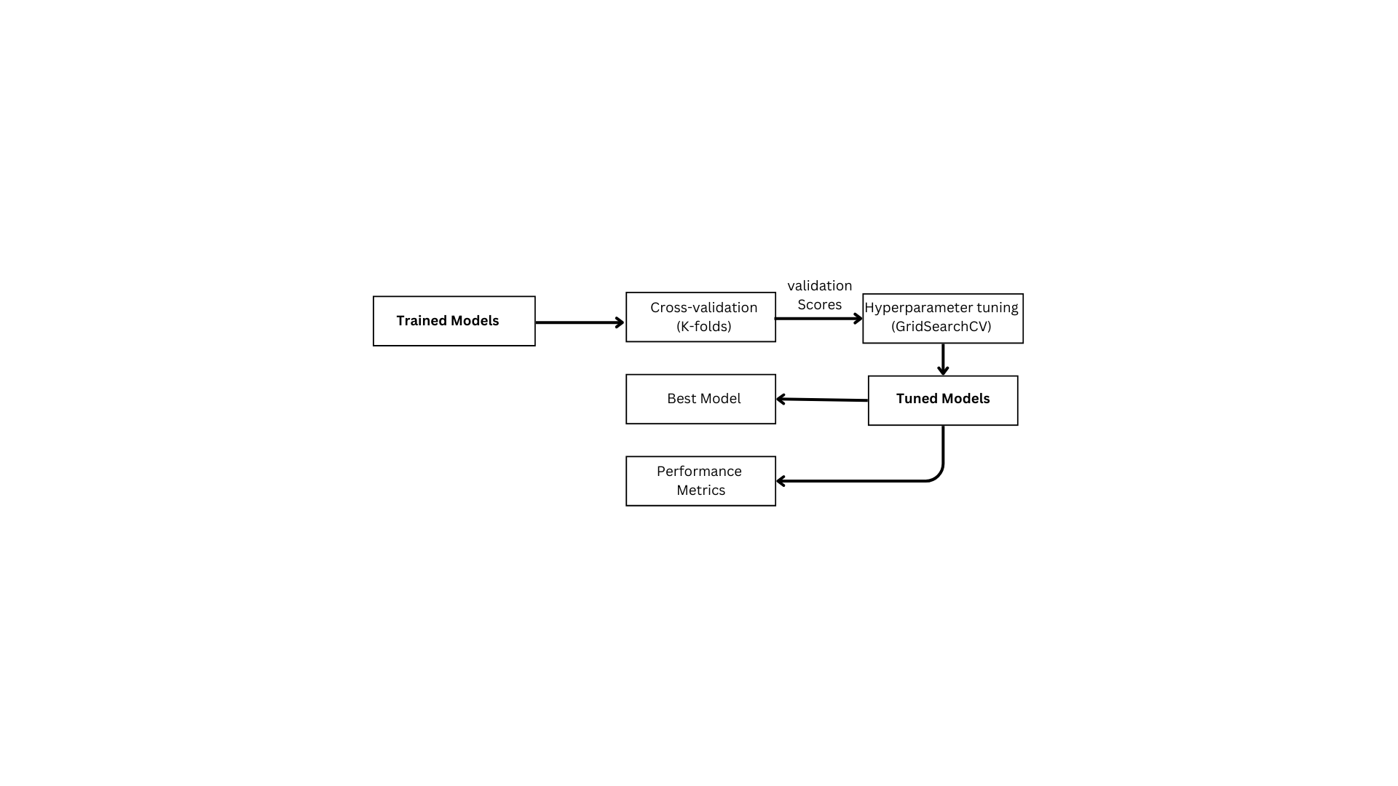
PROJECT MODULES AND DESCRIPTION
Workflow of Module Comparison and tuning Module

Slide 39
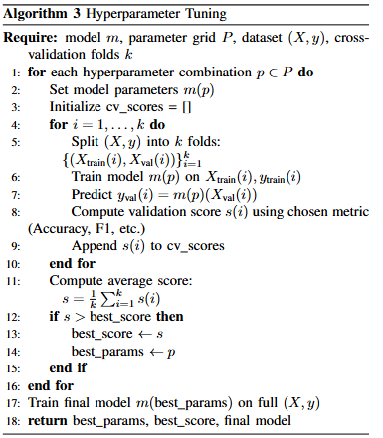
WORKING PSEUDOCODE

Slide 40
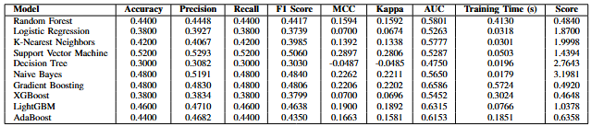
IMPLEMENTATIONS AND OUTPUTS
A performance comparison of multiple machine learning models, displaying key metrics such as accuracy, precision, recall, F1-score, MCC, Kappa, AUC, training time, and model scores, aiding in optimal model selection.

Slide 41
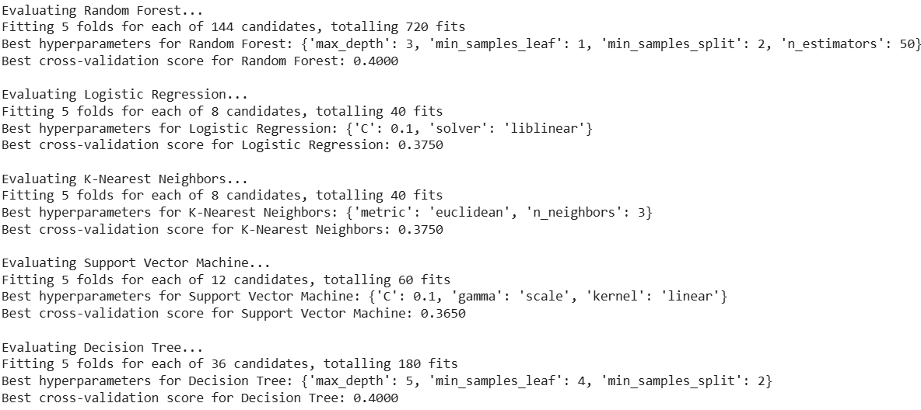
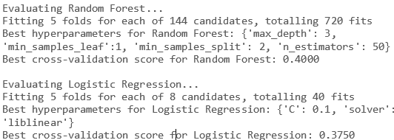
IMPLEMENTATIONS AND OUTPUTS
Hyperparameter tuning results for multiple machine learning models, detailing the best configurations found via GridSearchCV, along with cross-validation scores for optimal model selection.

Slide 42
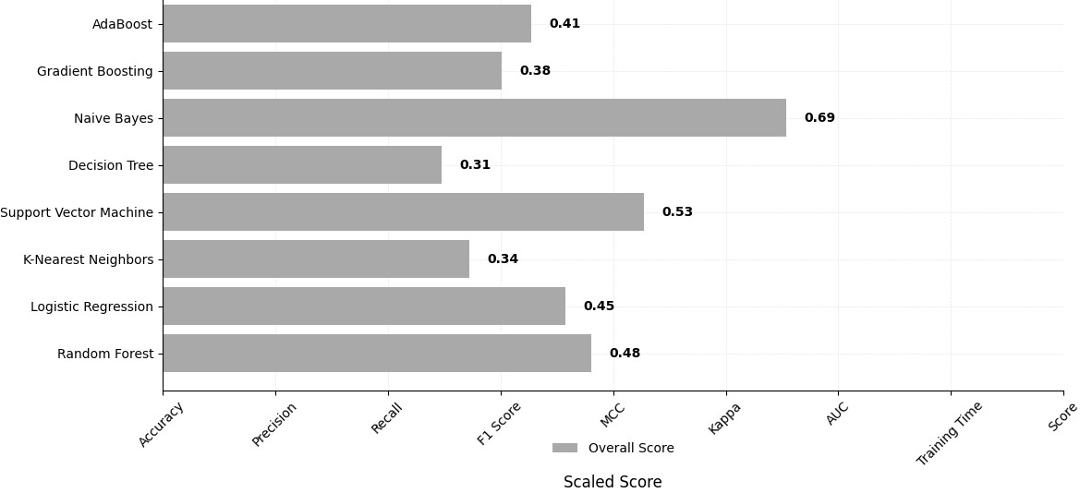
IMPLEMENTATIONS AND OUTPUTS
A bar chart comparing the overall scores of multiple machine learning models, highlighting Naive Bayes as the highest-scoring model.

Slide 43
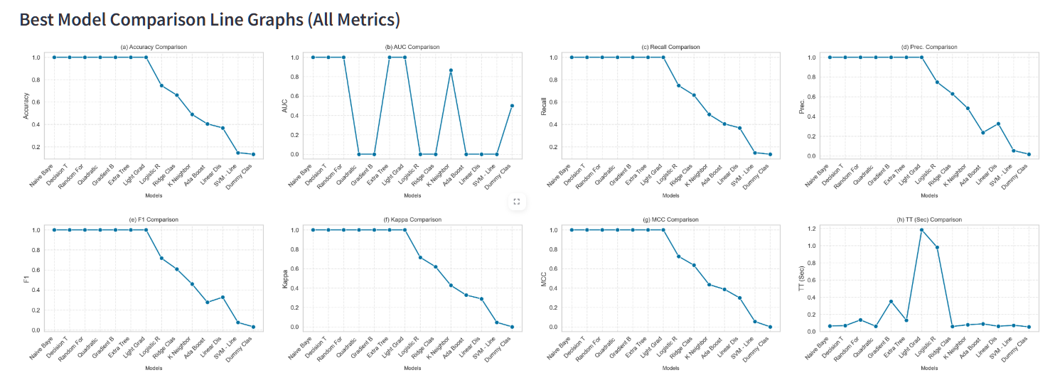
COMPARATIVE ANALYSIS
Performance visualizations of multiple machine learning models across key metrics—Accuracy, AUC, Recall, Precision, F1-score, Kappa, MCC, and Training Time—facilitating comparative analysis.

Slide 44
REFERENCES
S. Pahune and Z. Akhtar, ”Transitioning from MLOps to LLMOps: Navigating the Unique Challenges of Large Language Models,” Dept. Netw. Comput. Security, SUNY Polytechnic Inst., Utica, NY, USA, 2025, p. 36 on ResearchGate.
T. Hospedales, A. Antoniou, P. Micaelli and A. Storkey, "Meta-Learning in Neural Networks: A Survey," in IEEE Transactions on Pattern Analysis and Machine Intelligence, vol. 44, no. 9, pp. 5149-5169, 1 Sept. 2022, doi: 10.1109/TPAMI.2021.3079209.
M. Gutowska, S. Little and A. Mccarren, "Constructing a Meta-Learner for Unsupervised Anomaly Detection," in IEEE Access, vol. 11, pp. 45815-45825, 2023, doi: 10.1109/ACCESS.2023.3274113.
A. Ghosh, A. Sankararaman and K. Ramchandran, "Model Selection for Generic Contextual Bandits," in IEEE Transactions on Information Theory, vol. 70, no. 1, pp. 656-675, Jan. 2024, doi: 10.1109/TIT.2023.3298103.
Z. Liu, H. Wang and Y. Jin, "Performance Indicator-Based Adaptive Model Selection for Offline Data-Driven Multiobjective Evolutionary Optimization," in IEEE Transactions on Cybernetics, vol. 53, no. 10, pp. 6263-6276, Oct. 2023, doi: 10.1109/TCYB.2022.3170344.

Slide 45
REFERENCES
P. Mishra, C. Diwan, S. Srinivasa, and G. Srinivasaraghavan, "Automatic Title Generation for Text with Pre-trained Transformer Language Model," IEEE Transactions on Information Theory, vol. 50, no. 1, pp. 656-675, Jan. 2024, doi: 10.2109/TIT.2023.3458.
P. Huang, M. Xie and X. Yang, "Unsupervised Feature Selection via Controllable Adaptive Graph Learning and Discriminative Feature Learning," in IEEE Transactions on Neural Networks and Learning Systems, vol. 35, no. 11, pp. 15600-15614, Nov. 2024, doi: 10.1109/TNNLS.2023.3288734.w
Q. Hu, Y. Gao and B. Cao, "Curiosity-Driven Class-Incremental Learning via Adaptive Sample Selection," in IEEE Transactions on Circuits and Systems for Video Technology, vol. 32, no. 12, pp. 8660-8673, Dec. 2022, doi: 10.1109/TCSVT.2022.3196092.
S. Qiao, D. Shen, X. Wang, N. Han and W. Zhu, "A Self-Adaptive Parameter Selection Trajectory Prediction Approach via Hidden Markov Models," in IEEE Transactions on Intelligent Transportation Systems, vol. 16, no. 1, pp. 284-296, Feb. 2015, doi: 10.1109/TITS.2014.2331758.
B. Jiao, Y. Guo, D. Gong and Q. Chen, "Dynamic Ensemble Selection for Imbalanced Data Streams With Concept Drift," in IEEE Transactions on Neural Networks and Learning Systems, vol. 35, no. 1, pp. 1278-1291, Jan. 2024, doi: 10.1109/TNNLS.2022.3183120.

Slide 46
REFERENCES
M. Bother, T. Robroek, V. Gsteiger, R. Holzinger, X. Ma, P. T ¨ oz¨ un, and A. Klimovic, ”Modyn: Data-Centric ¨Machine Learning Pipeline Orchestration,” Proc. Int. Conf. Manage. Data (SIGMOD’25), ACM, New York,NY, USA, 2025, pp. 1–30.
M. Vettoruzzo, R. Bouguelia, J. Vanschoren, T. Rognvaldsson, and K. Santosh, ”Advances and Challenges in ¨Meta-Learning: A Technical Review,” in IEEE Transactions on Pattern Analysis and Machine Intelligence, vol.46, no. 7, pp. 4763-4779, July 2024, doi: 10.1109/TPAMI.2024.3357847.
B. Celik, P. Singh, and J. Vanschoren, ”Online AutoML: an adaptive AutoML framework for online learning,”Machine Learning, vol. 112, no. 6, pp. 1897–1921, 2023, doi: 10.1007/s10994-022-06262-0.
N. Shukla, A. Kolbeinsson, L. Marla, and K. Yellepeddi, ”Adaptive Model Selection Framework: AnApplication to Airline Pricing,” Journal of Machine Learning Research (JMLR),arXiv:1905.08874v1 [cs.LG],May 21, 2019, pp. 1-25.
F. Ming, W. Gong, L. Wang and Y. Jin, ”Constrained Multi-Objective Optimization With Deep ReinforcementLearning Assisted Operator Selection,” in IEEE/CAA Journal of Automatica Sinica, vol. 11, no. 4, pp. 919-931,April 2024, doi: 10.1109/JAS.2023.123687

